Slide 1
SharePoint Online File Protection and Permissions
Speaker Name

Slide 3
Objectives
After completing this section, you will:
Begin to understand and recognize services and features implemented by default in Microsoft 365 to secure your SharePoint Online data
Understand the default groups and permission levels used to provide specific levels of access to sites and content within SharePoint Online.
Notes:
This lesson provides Highlevel concepts and understanding of data security and protection features for content stored in SharePoint Online and OneDrive for Business
Highlevel concepts and understanding of device access management features for SharePoint Online and OneDrive for Business

Slide 4
File Protection

Slide 5
Default file encryption
By default, all files stored in Microsoft 365 are encrypted with the strongest encryption and detection technologies available.
In transit every file in SharePoint and OneDrive is encrypted uses SSL/TLS connections.
All SSL connections are established using 2048-bit keys.
Once the file reaches the Microsoft datacenter
Data is always encrypted at rest with BitLocker and Distributed Key Manager (DKM)
Per-file encryption goes even further by including a unique encryption key for each file
Further, every update to every file is encrypted using its own encryption key.
Before they’re stored, the keys to the encrypted files are themselves encrypted and stored in a physically separate location.
Every step of this encryption uses Advanced Encryption Standard (AES) with 256-bit keys and is Federal Information Processing Standard (FIPS) 140-2 compliant.
Notes:
As of October 31, 2018, Microsoft 365 will no longer support TLS 1.0 and 1.1. This means that Microsoft will not fix new issues that are found in clients, devices, or services that connect to Microsoft 365 by using TLS 1.0 and 1.1.
Note This doesn't mean Microsoft 365 will block TLS 1.0 and 1.1 connections. There is no official date for disabling or removing TLS 1.0 and 1.1 in the TLS service for customer connections. The eventual deprecation date will be determined by customer telemetry and is not yet known. After a decision is made, there will be an announcement six months in advance unless we become aware of a known compromise, in which case we may have to act in less than six months to protect customers who use the services.
You should make sure that all client-server and browser-server combinations use TLS 1.2 (or a later version) to maintain connection to Microsoft 365 services. You may have to update certain client-server and browser-server combinations.
The following clients are known to be unable to use TLS 1.2. Update your clients to ensure uninterrupted access to the service.
Android 4.3 and earlier versions
Firefox version 5.0 and earlier versions
Internet Explorer 8-10 on Windows 7 and earlier versions
Internet Explorer 10 on Win Phone 8.0
Safari 6.0.4/OS X10.8.4 and earlier versions
For more information about encryption used by Microsoft cloud services and datacenters, see the Data Encryption in OneDrive for Business and SharePoint Online.
https://docs.microsoft.com/en-us/office365/securitycompliance/data-encryption-in-odb-and-spo?redirectSourcePath=%252fen-us%252farticle%252f6501b5ef-6bf7-43df-b60d-f65781847d6c

Slide 6
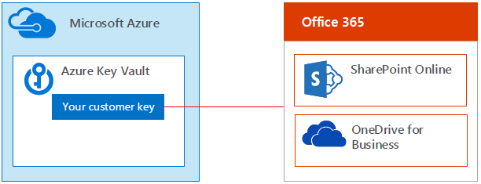
SharePoint Online service encryption with Customer Key
To help customers meet their compliance requirements, customers have the option to manage and control their own encryption keys for Microsoft 365.
All customer files in SharePoint Online are protected by unique, per-file keys that are always exclusive to a single tenant.
The keys are either created and managed by the SharePoint Online service, or when Customer Key is used
If a customer chooses to configure and use their own key, the customer key is stored in Azure Key Vault, and the service uses that key to encrypt a tenant key, which is used to encrypt a site key, which is then used to encrypt the file level keys.
Essentially, a new key hierarchy is introduced when the customer provides a key.

Slide 7
Permissions

Slide 8
Team site permissions and Microsoft 365 Groups
Each SharePoint team site is part of a Microsoft 365 group
When you add owners or members to the Microsoft 365 group, they're given access to the SharePoint site (along with the other services connected to that group).
Group owners become site owners, and group members become site members.
It's possible to manage SharePoint site permissions separately from the Microsoft 365 group by using SharePoint groups, but we recommend against it.
In such a case, group members will continue to have access to the site, but users added directly to the site won't have access to any of the group services.
The exception is view-only access
Microsoft 365 groups don't have view-only access, so any users you wish to have view permissions on the site must be added directly to the Visitors group on the site.

Slide 9
Communication site permissions
Communication sites aren't connected to Microsoft 365 groups and use the standard SharePoint permissions groups:
Owners
Members
Visitors
You can give people permissions to the site by adding individual users, security groups, or Microsoft 365 groups to one of the three SharePoint groups.
Nested security groups can cause performance issues and are not recommended
The visitors group is a good place to use security groups. In many organizations, this is the easiest way to add large numbers of users to a site.

Slide 10
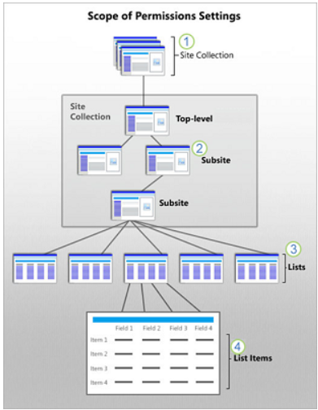
SharePoint Online permissions inheritance overview
Every site in Sharepoint Online exists in a site collection, which is a group of sites under a single top-level site.
The top-level site is called the root site of the site collection
By default, all the sites and site content in a collection inherit the permissions settings of the root or top-level site.
If you assign unique permissions to sites, libraries, and items, those items no longer inherit permissions from their parent site
A site collection administrator configures permissions for the top level (root) site for the entire site collection.
Subsite owners can change permission settings for their subsite, which stops permission inheritance for the site
Lists and libraries inherit permissions from the site to which they belong.
List items and library files inherit permissions from their parent list or library.
Notes:
A site collection administrator configures permissions for the top level (root) site for the entire site collection.
Subsite owners can change permission settings for their subsite, which stops permission inheritance for the site
Lists and libraries inherit permissions from the site to which they belong. If you are a site owner, you can stop permissions inheritance and change the permission settings for the list or library.
List items and library files inherit permissions from their parent list or library. If you have control of a list or library, you can stop permissions inheritance and change permissions settings directly on a specific item.

Slide 11
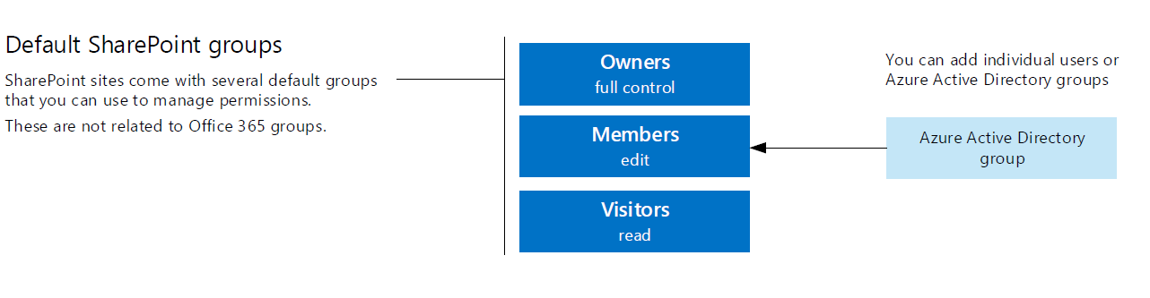
Permissions for SharePoint
You can use permissions in SharePoint to provide or restrict user access to the site or it’s contents.

Slide 12
Default Permission Levels
Permission level | Description
View Only | Enables users to view application pages. The View Only permission level is used for the Excel Services Viewers group.
Limited Access | Enables users to access shared resources and a specific asset. Limited Access is designed to be combined with fine-grained permissions to enable users to access a specific list, document library, folder, list item, or document, without enabling them to access the whole site. Limited Access cannot be edited or deleted. Note: when sharing a link to a document with all users in your organization, SharePoint will assign the Limited Access permission via a group name "Limited Access System Group" that is applied the first time a user accesses the resource who does not otherwise have permission via the link
Read | Enables users to view pages and list items, and to download documents.
Contribute | Enables users to manage personal views, edit items and user information, delete versions in existing lists and document libraries, and add, remove, and update personal Web Parts.
Edit | Enables users to manage lists.
Design | Enables users to view, add, update, delete, approve, and customize items or pages in the website.
Full Control | Enables users to have full control of the website.

Slide 13
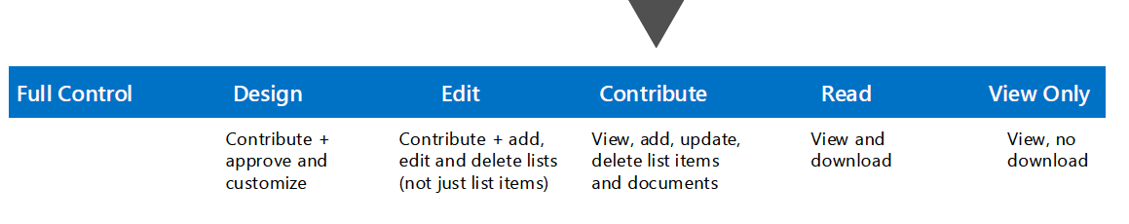
Create a custom group for fine-grained control
While still available, in Modern Team sites with Groups associated with them creating custom SharePoint Permission Levels in not advised.
Using the Group membership permissions is the best practice.
The default SharePoint groups are created automatically when you create a site collection.
The default groups use SharePoint's default permission levels - sometimes called SharePoint roles - to grant users rights and access.
The permission levels that these groups have represent common levels of access that users must have and are a good place to start when you add users to a SharePoint site.
Custom groups in SharePoint Online let you choose fine-grained permission levels.
Notes:
Understanding permission levels in SharePoint
https://docs.microsoft.com/en-us/sharepoint/understanding-permission-levels?redirectSourcePath=%252fen-US%252farticle%252fUnderstanding-permission-levels-in-SharePoint-87ecbb0e-6550-491a-8826-c075e4859848
Understanding SharePoint groups
https://docs.microsoft.com/en-us/sharepoint/default-sharepoint-groups?redirectSourcePath=%252fen-US%252farticle%252fUnderstanding-SharePoint-groups-94d9b261-161e-4ace-829e-eca1c8cd2eb8

Slide 14
Knowledge Check
True or False - Every file in SharePoint and OneDrive is encrypted in transit?
What are the default SharePoint permissions groups in Communication sites?
True or False: The Limited Access permission level can be manually assigned to users and groups in a SharePoint site
True - Files in SharePoint and OneDrive are encrypted in transit using SSL/TLS connections. All SSL connections are established using 2048-bit keys.
Owners, Members, Visitors
False - This permission level is automatically assigned by SharePoint when you provide access to one specific item. You cannot assign Limited Access permissions directly to a user or group yourself
Notes:
In transit every file in SharePoint and OneDrive is encrypted?
Answer: In transit every file in SharePoint and OneDrive is encrypted in transit (TLS 1.2) between the user’s browser, PC, Mac, or mobile device and our datacenters.
NOTE: As of October 31, 2018, Microsoft 365 will no longer support TLS 1.0 and 1.1. This means that Microsoft will not fix new issues that are found in clients, devices, or services that connect to Microsoft 365 by using TLS 1.0 and 1.1.
Note This doesn't mean Microsoft 365 will block TLS 1.0 and 1.1 connections. There is no official date for disabling or removing TLS 1.0 and 1.1 in the TLS service for customer connections. The eventual deprecation date will be determined by customer telemetry and is not yet known. After a decision is made, there will be an announcement six months in advance unless we become aware of a known compromise, in which case we may have to act in less than six months to protect customers who use the services.
What are some of the tradeoffs if Azure Rights Management is applied to files stored in SharePoint Online and OneDrive for Business? Answer: The Microsoft 365 service cannot process the contents of these files. Therefore Co-authoring, eDiscovery, search, Delve, and other collaborative features will not work.
Azure Conditional Access policy based on device state (ie, domain joined, non-domain joined, compliant with Intune policies) requires what level of Azure Active Directory subscription
Answer: No. It is recommended that security groups and/or Active Directory groups are used in SharePoint groups when possible.

Slide 15
Summary
In this lesson, you learned how to:
Understand and recognize services and features implemented by default in Microsoft 365 to secure your SharePoint Online data
Understand and recognize services additional and features you can implement in order to provide additional layers of security for SharePoint Online and OneDrive for Business

